Slide 1

Chapter 3
Ownership, permissions, and file management

Slide 2
Commands
ls (list files)
mkdir/rmdir (make and remove directory)
touch (create a blank file or change file attributes)
cp (copy files)
mv (move or rename files)
rm (delete files)
chown (change the owner of files)
chmod (change the mode (permissions) of files)
find (find files based on file name or attributes)

Slide 3
Listing Files/Directories
ls [options] /path/to/directory
-l (long) -a (all files) -t (last modified date) -r (reverse) -1 (single column) -R (recursively) -h (human readable)
$ sudo ls –lar /scripts/work

Slide 4
Make/Remove Directory
mkdir [-mpv] /path/to/directory
rmdir [-pv] /path/to/directory
-m (mode as in chmod) -p (create parent directories) -v (verbose)
$ mkdir –p /home/dave/directory1/directory2
create /home/dave/directory1/directory2 and any parent directories required

Slide 5
Touch a file
touch [options] /path/to/filename
-a, change the access time only -c, if the file does not exist, do not create it -m, change the modification time only -r file, use the access and modification times of file -t time, use the time specified to update the access and modification times
time format [[cc]yy]MMDDhhmm[.ss]
$ touch ~/my_new_file.txt

Slide 6
Copying Files/Directories
cp [options] /path/to/source-file /path/to/dest-file
-R (recursively) -f (force) -i (interactive)
$ cp ~/my_new_file copy_of_new_file

Slide 7
Moving/Renaming
mv [options] /path/to/file1 /path/to/newlocation
-f (force - no prompt on overwrite) -i (interactive - prompt before overwrite) -u (update - only overwrite if newer)
moving files maintains file attributes (permissions/modified date) – copy does not
$ mv file1 file2
rename file1 to file2 in the present working directory

Slide 8
Removing Files
rm [options] /path/to/files
-f (force) -R (recursively) -i (prompt for each file)
$ rm ~/old_file
delete old_file in your home directory
$ rm -Rf backup
remove backup directory and all of its contents

Slide 9


Slide 10
Change Ownership
chown [–R] user:group /path/to/file
-R (recursively)
$ sudo chown –R linuxuser:linuxuser /home/dave/mydirectory change the owner and group of all files/directories in the mydirectory folder and below (recurse)

Slide 11
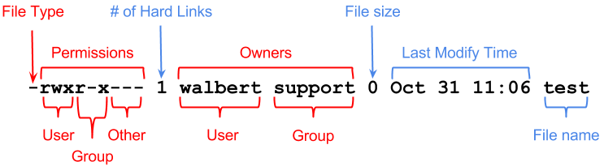
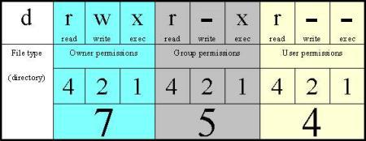
Permissions
chmod [option] [mode] /path/to/file
-R (recursively)
$ sudo chmod 754 /home/dave/taxes.txt

Slide 12
find
find /dir [options]
-name (case sensitive filename) -iname (case insensitive filename) -mmin xx (modified in the last xx minutes) -mtime xx (modified in the last xx days) -perm [mode] (has permissions of [mode] (ie. 0660) -exec (execute a command using the found file)
* the find command is recursive by default *

Slide 13
find example
$ sudo find /scripts/work/ -name “m*”
/scripts/work/episcopant/refreshfully/mowdiewart /scripts/work/episcopant/malmier /scripts/work/episcopant/malmier/overgrass/meitnerium’s /scripts/work/episcopant/Soviets/mistold /scripts/work/episcopant/Soviets/ebonist/mumness

Slide 14
find example
$ sudo find /scripts/work/ -iname “y*”
/scripts/work/episcopant/refreshfully/Yacc /scripts/work/episcopant/gittern's/leptosomic/yook /scripts/work/Keelby/peatman/darrein/yippers /scripts/work/fistmeles/hillwort/yirred /scripts/work/sereneness/Mycetophagidae/noctiferous/Yaren

Slide 15
find + move example
* Journal this command. It WILL be on tests/exams! *
find all files in the /scripts/work directory that have .mp3 as an extension and move them to /home/dave/Music:
$ sudo find /scripts/work/ -iname “*.mp3” –exec mv {} /home/dave/Music \;

